Slide 1
Unit 3
Kruskal’s Algorithm

Slide 2
Kruskal’s Algorithm
Kruskal’s Algorithm is a famous greedy algorithm.
It is used for finding the Minimum Spanning Tree (MST) of a given graph.
To apply Kruskal’s algorithm, the given graph must be weighted, connected and undirected.

Slide 3
Kruskal’s Algorithm
Sort all the edges from low weight to high weight.
Take the edge with the lowest weight and use it to connect the vertices of graph.
If adding an edge creates a cycle, then reject that edge and go for the next least weight edge.
Keep adding edges until all the vertices are connected and a Minimum Spanning Tree (MST) is obtained.

Slide 4
The above steps may be reduced to the following thumb rule-
Simply draw all the vertices on the paper.
Connect these vertices using edges with minimum weights such that no cycle gets formed.

Slide 5
Kruskal’s Algorithm Time Complexity-
Worst case time complexity of Kruskal’s Algorithm
= O(ElogV) or O(ElogE)
The edges are maintained as min heap.
The next edge can be obtained in O(logE) time if graph has E edges.
Reconstruction of heap takes O(E) time.
So, Kruskal’s Algorithm takes O(ElogE) time.
The value of E can be at most O(V²).
So, O(logV) and O(logE) are same.

Slide 6
Special Case:
If the edges are already sorted, then there is no need to construct min heap.
So, deletion from min heap time is saved.
In this case, time complexity of Kruskal’s Algorithm = O(E + V)

Slide 7
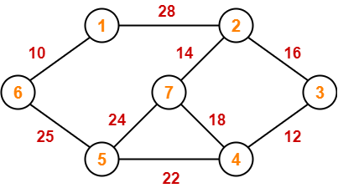
Construct the minimum spanning tree (MST) for the given graph using Kruskal’s Algorithm-
To construct MST using Kruskal’s Algorithm,
Simply draw all the vertices on the paper.
Connect these vertices using edges with minimum weights such that no cycle gets formed.

Slide 8
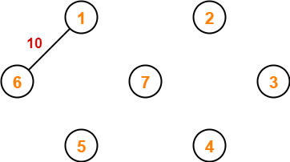
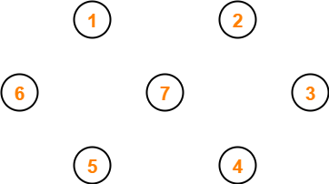
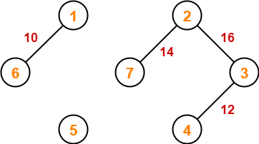
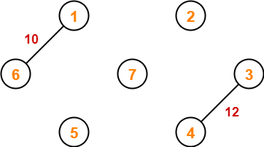

Slide 9
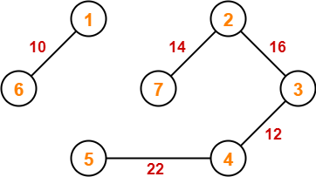
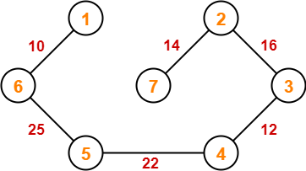
Since all the vertices have been connected / included in the MST, stop.
Weight of the MST
= Sum of all edge weights
= 10 + 25 + 22 + 12 + 16 + 14
= 99 units

Slide 10
Prim’s Algorithm-
Prim’s Algorithm is a famous greedy algorithm.
It is used for finding the Minimum Spanning Tree (MST) of a given graph.
To apply Prim’s algorithm, the given graph must be weighted, connected and undirected.

Slide 11
Prim’s Algorithm
Randomly choose any vertex.
The vertex connecting to the edge having least weight is usually selected.
Find all the edges that connect the tree to new vertices.
Find the least weight edge among those edges and include it in the existing tree.
If including that edge creates a cycle, then reject that edge and look for the next least weight edge.
Keep repeating step-02 until all the vertices are included and Minimum Spanning Tree (MST) is obtained.

Slide 12
Prim’s Algorithm Time Complexity-
Worst case time complexity of Prim’s Algorithm is-
O(ElogV) using binary heap
O(E + VlogV) using Fibonacci heap

Slide 13
Time Complexity Analysis
If adjacency list is used to represent the graph, then using breadth first search, all the vertices can be traversed in O(V + E) time.
We traverse all the vertices of graph using breadth first search and use a min heap for storing the vertices not yet included in the MST.
To get the minimum weight edge, we use min heap as a priority queue.
Min heap operations like extracting minimum element and decreasing key value takes O(logV) time.
So, overall time complexity
= O(E + V) x O(logV)
= O((E + V)logV)
= O(ElogV)

Slide 14
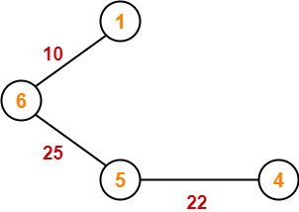
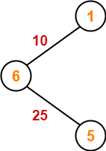
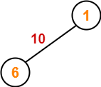
Construct the minimum spanning tree (MST) for the given graph using Prim’s Algorithm-

Slide 15
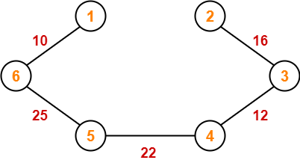
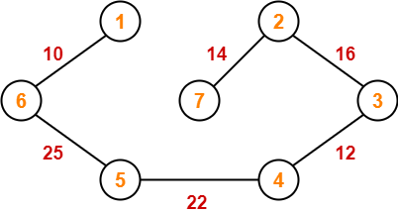
Since all the vertices have been included in the MST, stop.
Now, Cost of Minimum Spanning Tree
= Sum of all edge weights
= 10 + 25 + 22 + 12 + 16 + 14
= 99 units

Slide 16
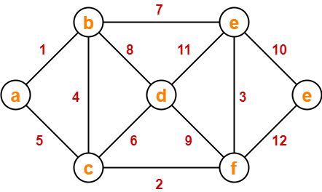
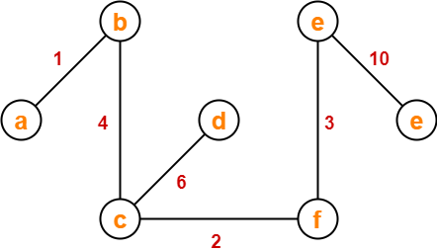
Now, Cost of Minimum Spanning Tree
= Sum of all edge weights
= 1 + 4 + 2 + 6 + 3 + 10
= 26 units

